Slide 1
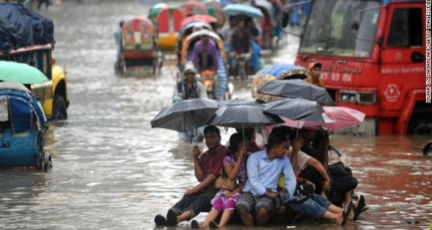

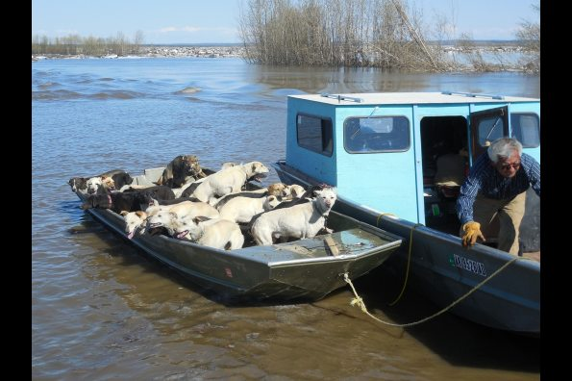
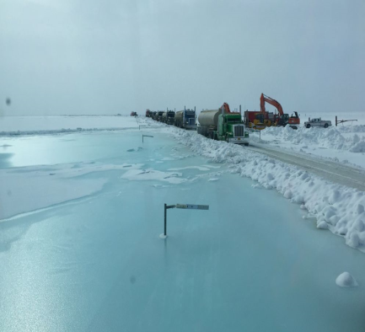
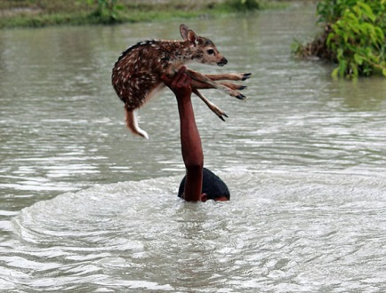



Contributions of GEO-LEO Satellite Imagery in Flood Mapping for Flood Forecasting and Monitoring
Sanmei Li Donglian Sun
George Mason University, USA
Mitch Goldberg Bill Sjoberg
NOAA JPSS Program Office, USA
June 25, 2019, Chengdu, China

Slide 2

Outline
Background
Introduction to the Version 1.0 software
  Algorithm and software development
  Evaluation and validation
  Application of the VIIRS flood products
Integration with GOES-16/ABI data in the flood mapping software
  Potential improvement from ABI data
  Development of the ABI flood mapping software
Development of GEO-LEO flood product
Future plan
Reference

Slide 3
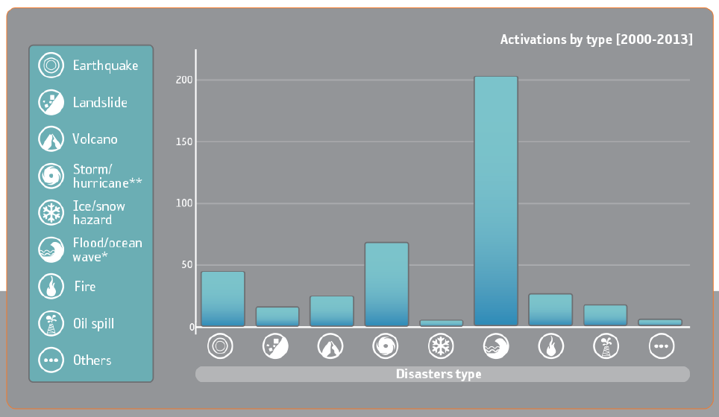
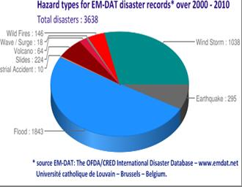
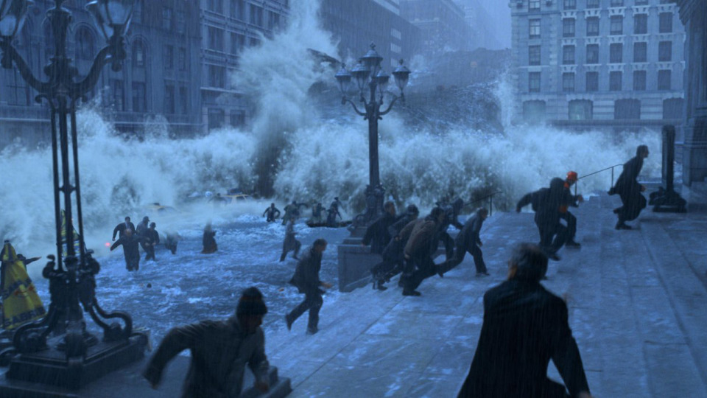
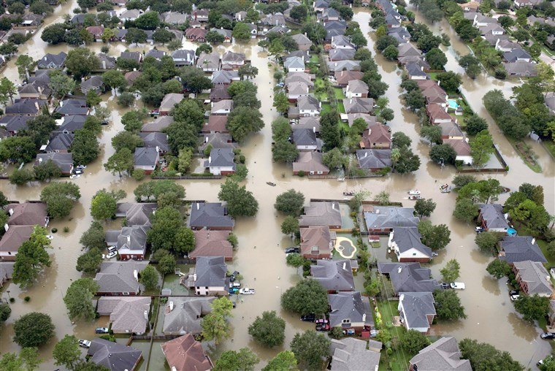
Flood ̶ A frequent and costly natural disaster
WMO’s International Charter
New York flood in 2012:
233 killed, economic loss: $75B
Hurricane Harvey flood in 2017:
107 killed, economic loss: $125B

Slide 4
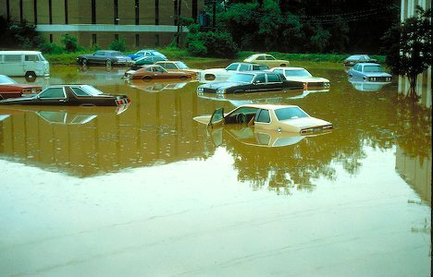
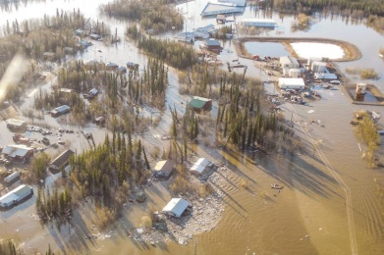
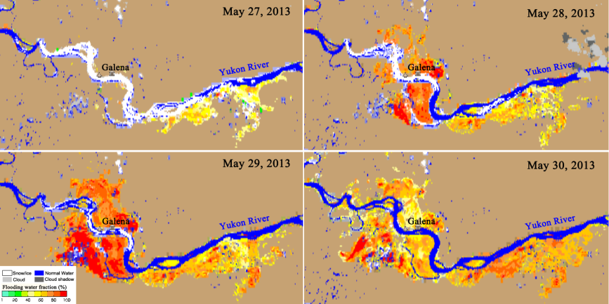
Background
An ice-jam flood occurring in Galena, Alaska in May, 2013 attracted a lot of attention. The flood changed rapidly and many local Alaskans were evacuated during mid night.
Many other destructive floods urge more attention to flood detection.
SNPP/VIIRS data show special advantages in flood detection.
  3000km swath without gaps even at the equator and constant 375-m spatial resolution across the scan in Imager bands
Initialized by JPSS Proving Ground & Risk Reduction Program since 2013, flood detection software has been developed to generate near real-time flood products using SNPP/VIIRS imagery.

Slide 5
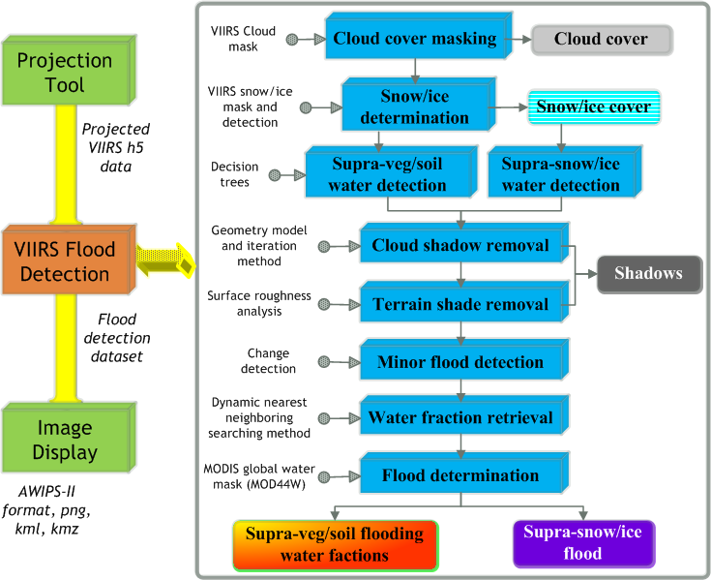
Development of the VIIRS flood mapping software Version 1.0
Module 1:
  Capability:
  To detect flood in any land regions between 80°S and 80°N under solar zenith angles less than 85°automatically.
  To produce VIIRS 375-m floodwater fraction products.
Module 2:
Module 3:
Version 1.0 Software components and algorithm flow

Slide 6
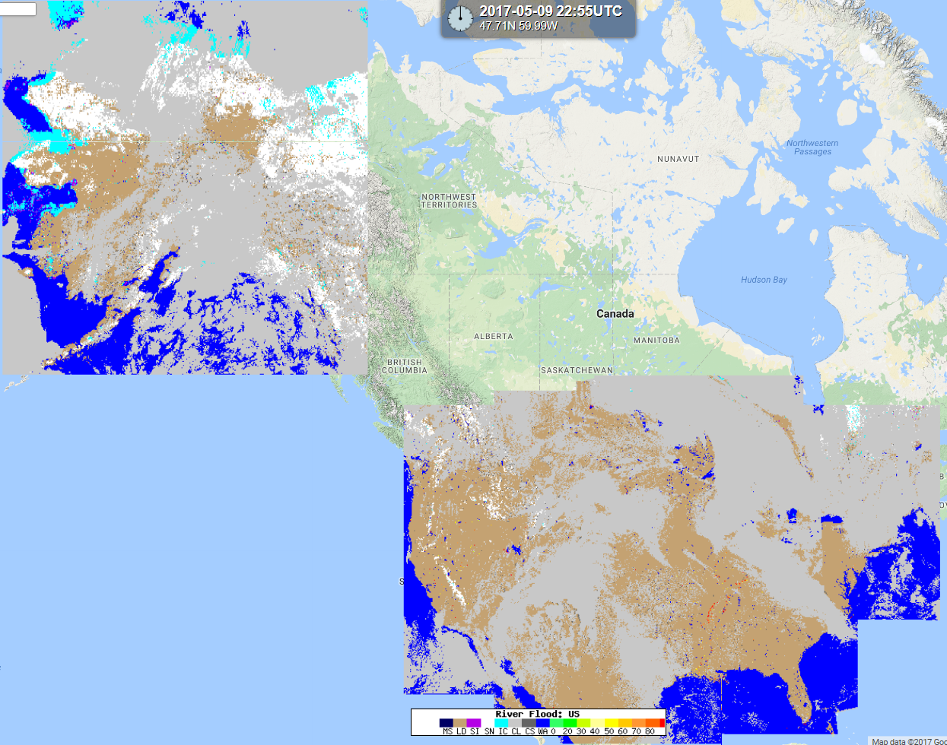
Routine Process
  Near real-time process: running routinely at SSEC and GINA using SNPP direct broadcast data.
  Products are available in AWIPS-II and SSEC’s Real Earth.
SNPP/VIIRS 375-m near real-time flood maps are now routinely available in the CONUS and Alaska: http://realearth.ssec.wisc.edu/?products=RIVER-FLDall-US

Slide 7
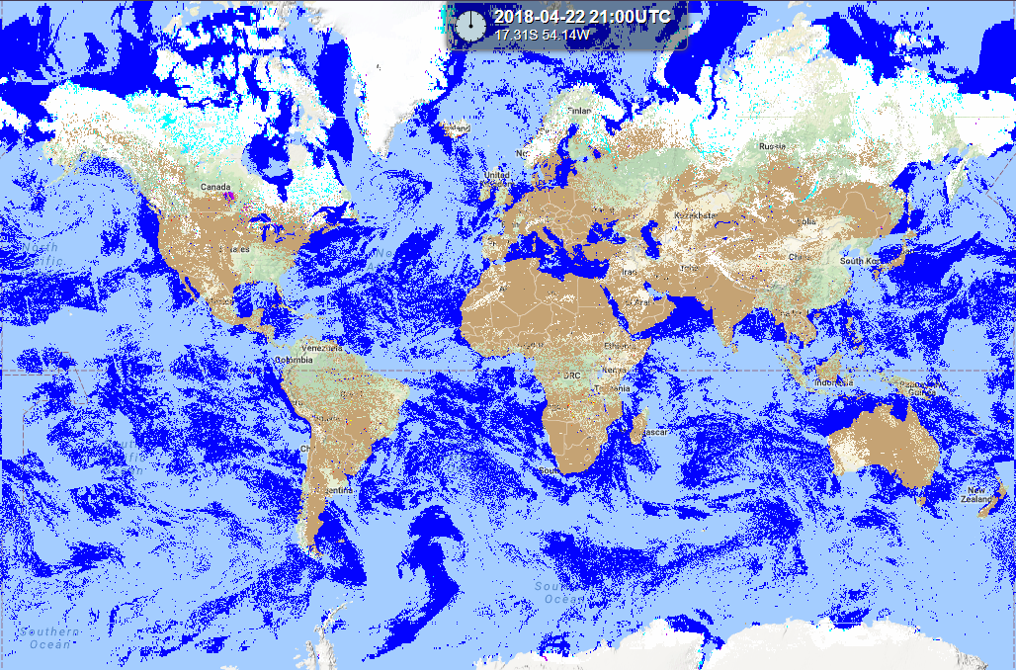
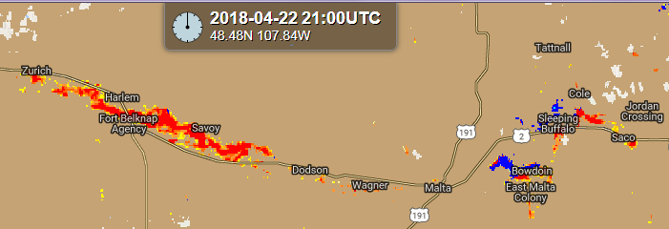
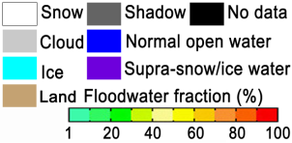
CSPP is now processing daily global VIIRS flood maps and distributes the maps through Real Earth.

Slide 8



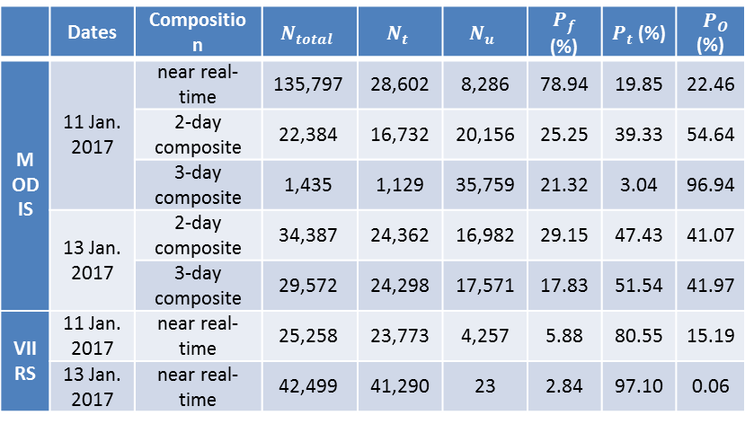


Comparison with MODIS flood product
 | Dates | Composition | $$N_{total}$$ | $$N_{t}$$ | $$N_{u}$$ | $P_{f}$ (%) | $P_{t}$ (%) | $P_{O}$ (%)
MODIS | 11 Jan. 2017 | near real-time | 135,797 | 28,602 | 8,286 | 78.94 | 19.85 | 22.46
 |  | 2-day composite | 22,384 | 16,732 | 20,156 | 25.25 | 39.33 | 54.64
 |  | 3-day composite | 1,435 | 1,129 | 35,759 | 21.32 | 3.04 | 96.94
 | 13 Jan. 2017 | 2-day composite | 34,387 | 24,362 | 16,982 | 29.15 | 47.43 | 41.07
 |  | 3-day composite | 29,572 | 24,298 | 17,571 | 17.83 | 51.54 | 41.97
VIIRS | 11 Jan. 2017 | near real-time | 25,258 | 23,773 | 4,257 | 5.88 | 80.55 | 15.19
 | 13 Jan. 2017 | near real-time | 42,499 | 41,290 | 23 | 2.84 | 97.10 | 0.06
TERRA/MODIS, Jan. 11, 2017
$N_{total}$: the total number of detected flood pixels
$N_{t}$ : the total number of true flood pixels
$N_{u}$: the total number of undetected flood pixels
False detection ratio:
$$P_{f}=\frac{N_{total}−N_{t}}{N_{total}}×100\%$$
VIIRS, Jan. 11, 2017
Commission ratio:
$$P_{t}=\frac{N_{t}}{N_{total}+N_{u}}×100\%$$
Omission ratio:
$$P_{O}=\frac{N_{u}}{N_{t}+N_{u}}×100\%$$
MODIS flood product data source: http://oas.gsfc.nasa.gov/floodmap

Slide 9
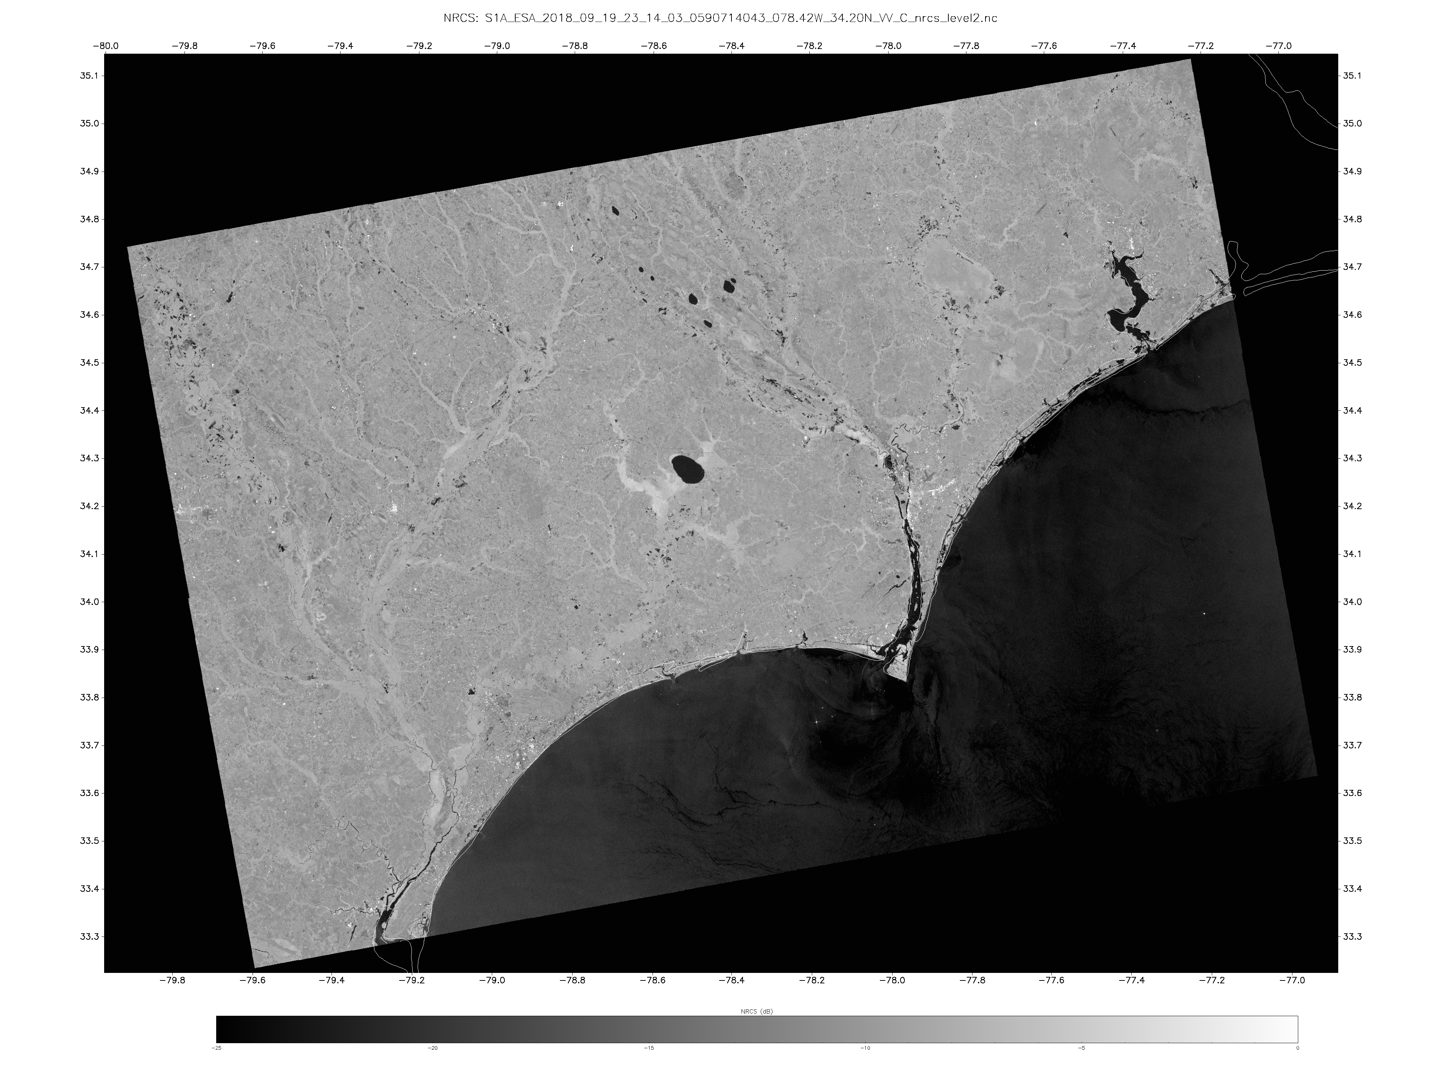
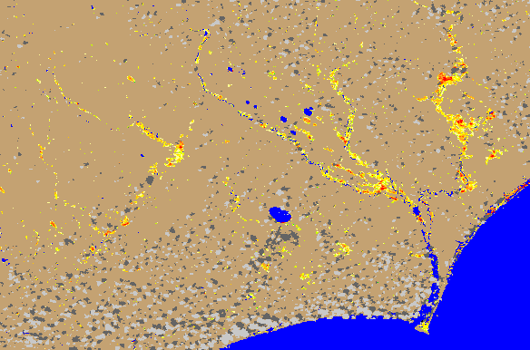

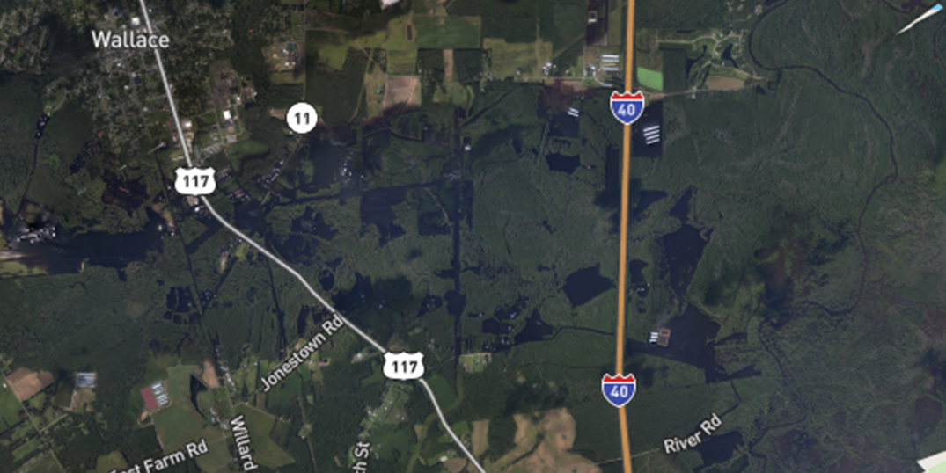
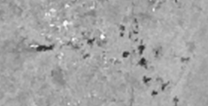
Sentinel-1 image on Sep. 19, 2018 in the southeast of USA
VIIRS flood map on Sep. 19, 2018 in the southeast of USA
Wallace
Ground truth on Sep. 19, 2019: most flooding water was veiled by vegetation cover.
VIIRS
Wallace
SAR

Slide 10
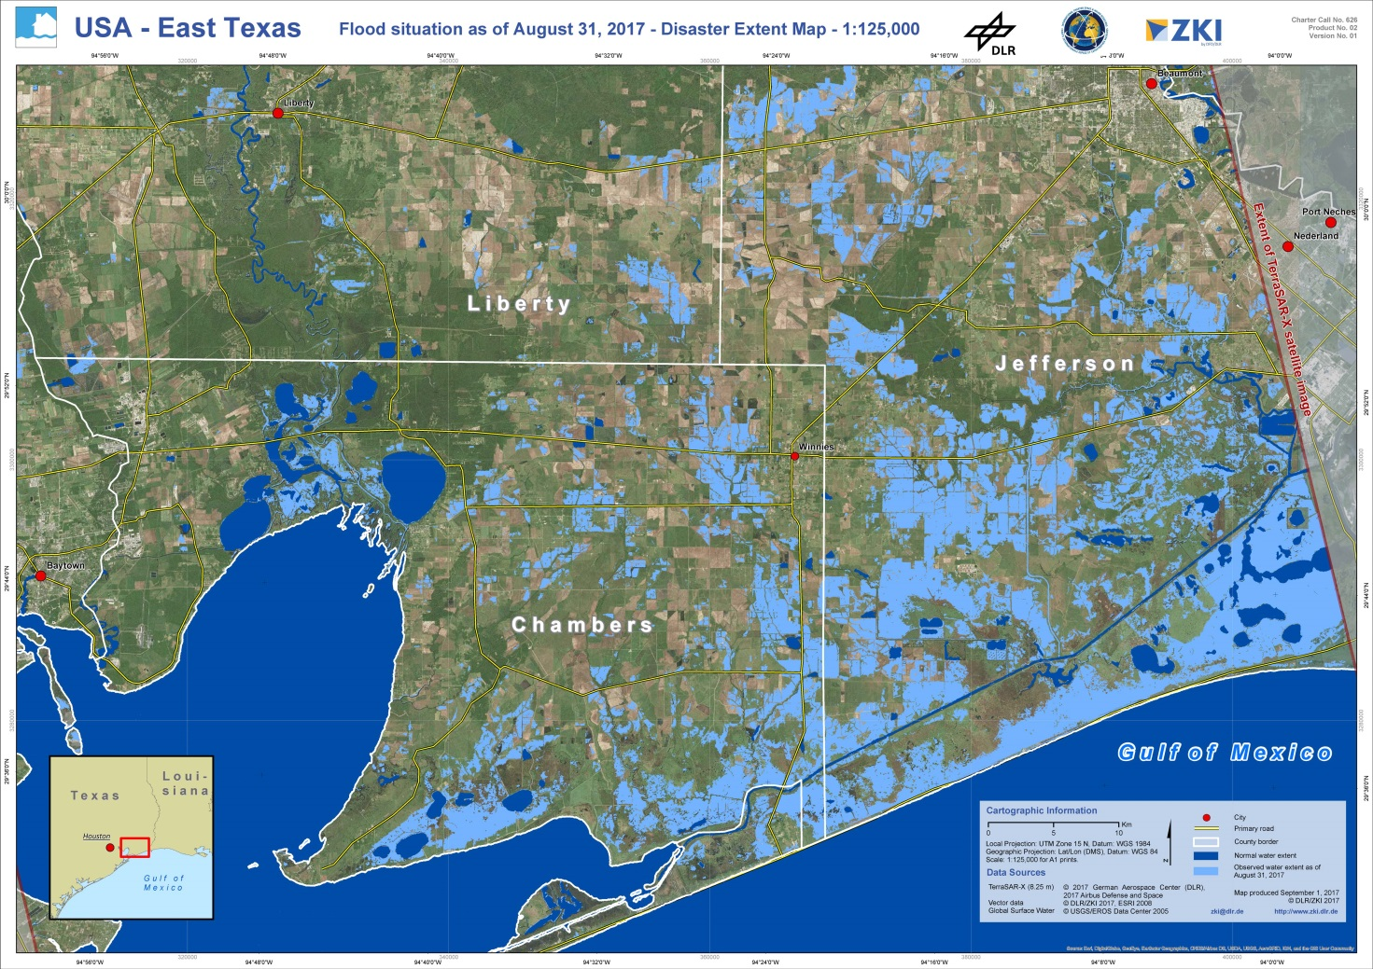
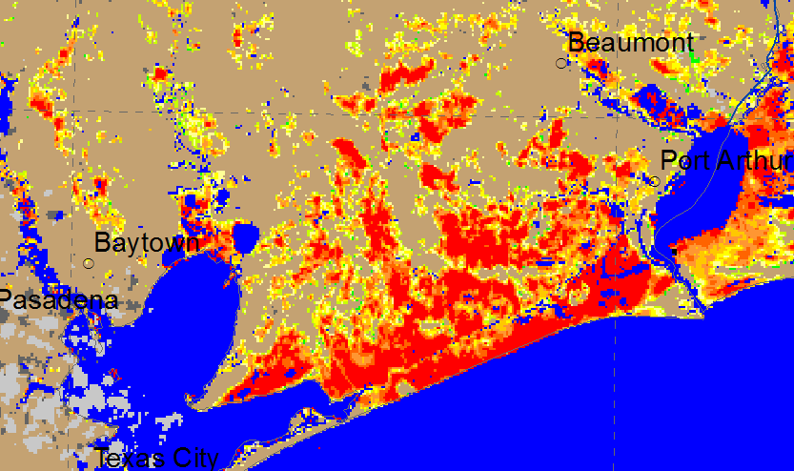
Comparison with Sentinel-1 flood product
Sentinel-1 flood map on Aug. 31, 2017 in West Gulf region, USA
Overall, VIIRS shows consistent flood detection results with Sentinel-1.
Over vegetation cover region, VIIRS might show larger flood extent than Sentinel-1.
VIIRS 375-m flood map in the similar region with Sentinel-1 on Aug. 31, 2017

Slide 11
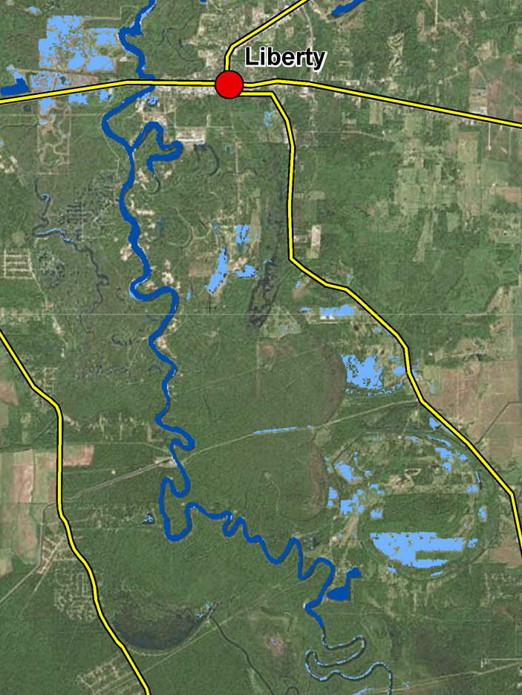
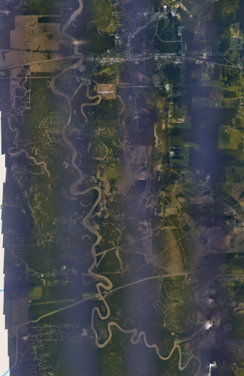
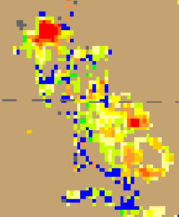
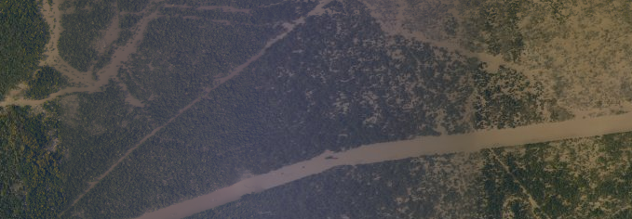
Liberty
Liberty
Sentinel-1 on Aug. 31, 2017
VIIRS on Aug. 31, 2017
Ground truth on Sep. 02, 2017

Slide 12
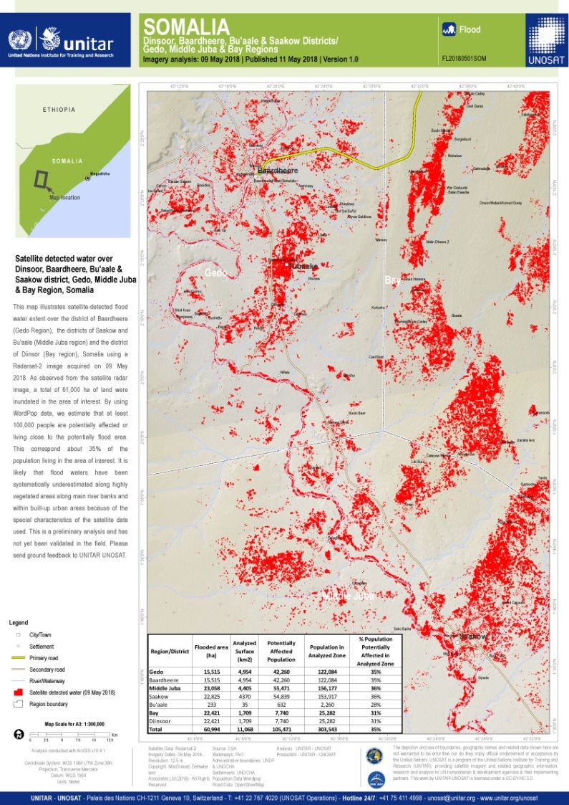
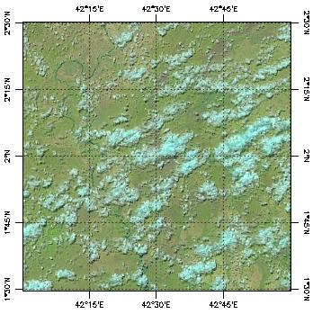
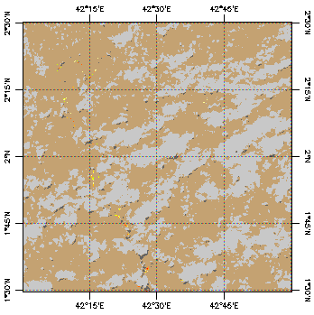

Comparison with Radarsat flood product
VIIRS false-color image on May 07, 2018 10:33 (UTC)
VIIRS flood map on May 07, 2018 10:33 (UTC)
UNOSAT flood map on May 09, 2018
  Compare VIIRS results (no significant flooding) with Radarsat flood results (major flooding) on Somalia flood.

Slide 13
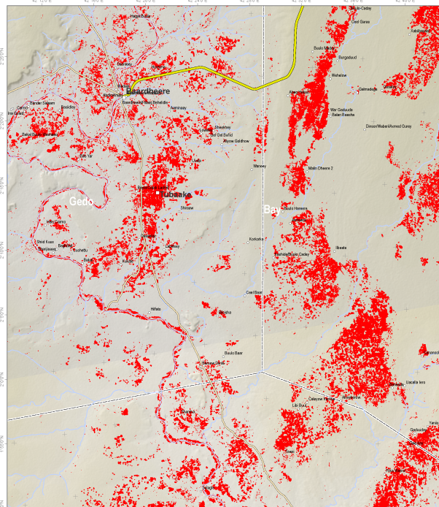
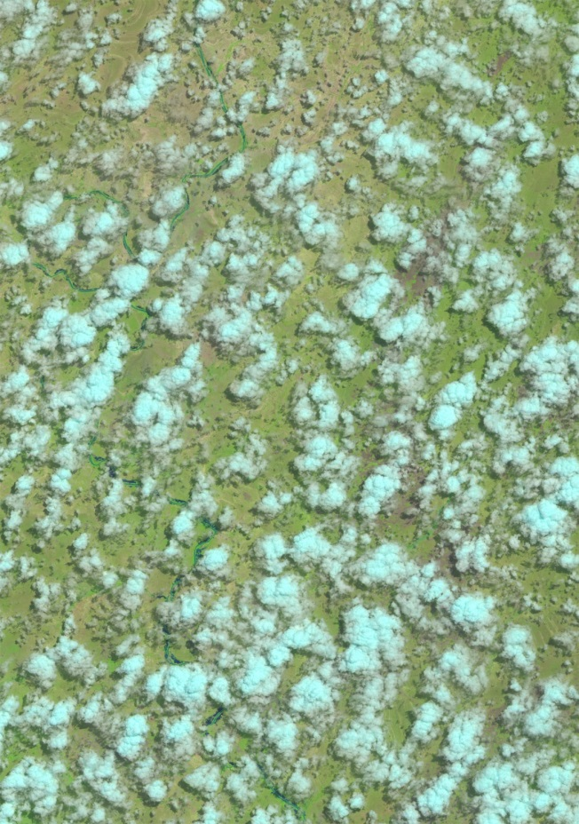
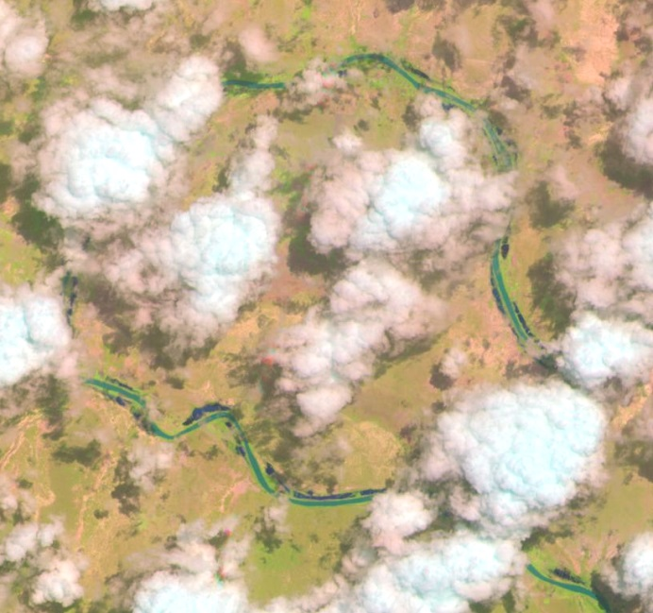
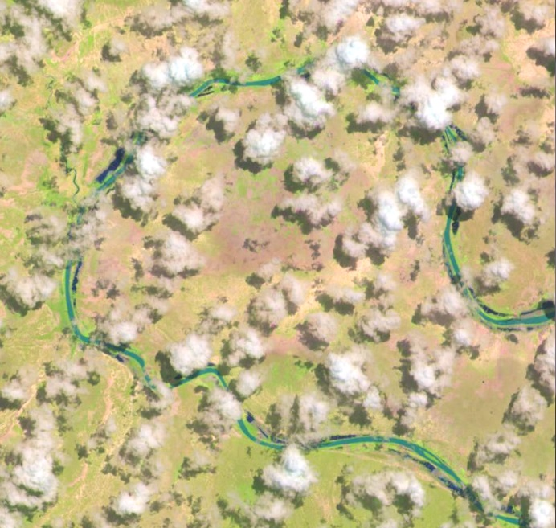
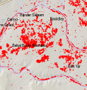
Sentinel-2B May 08, 2018
Sentinel-2B image on May 08, 2018
UNOSAT flood map on May 09, 2018
  VIIRS can still help even though the flood mapping has been dominated by radar satellite imagery.
Sentinel-2B May 03, 2018

Slide 14
Evaluation with Landsat imagery
Landsat
VIIRS
Supra-veg/bare soil water
Supra-snow/ice water

Slide 15
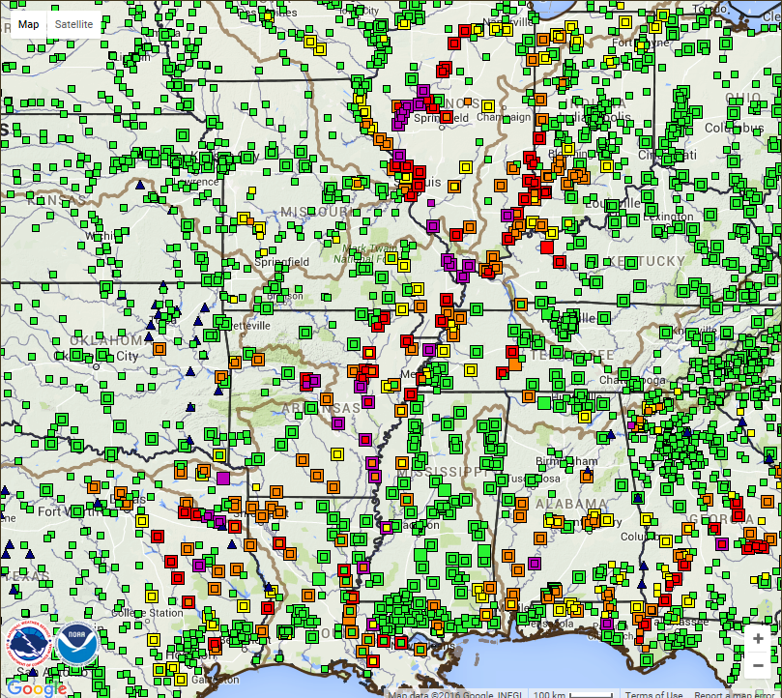

Application
River gauge map on Jan. 03, 2016
What do those floods look like?
Provide river forecasters with situational awareness info for flood forecasting.
Notes:
Do you mean areal (as in the region) or aerial (meaning, from above)?

Slide 16
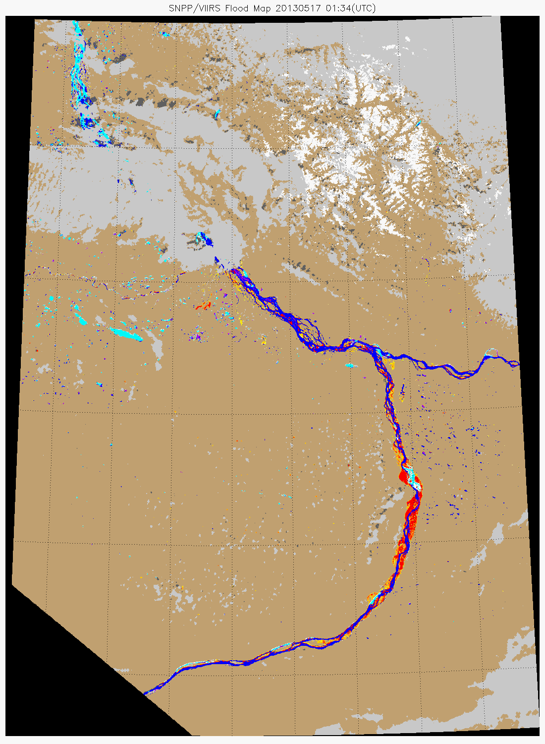
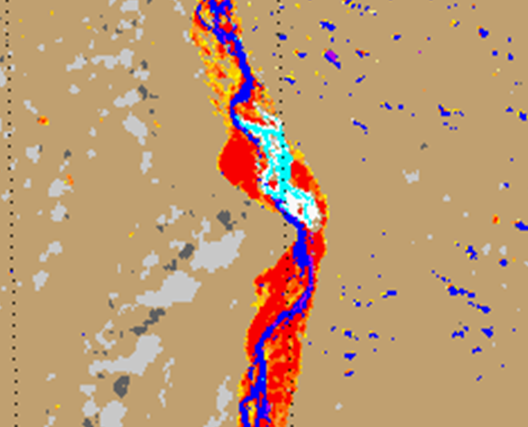
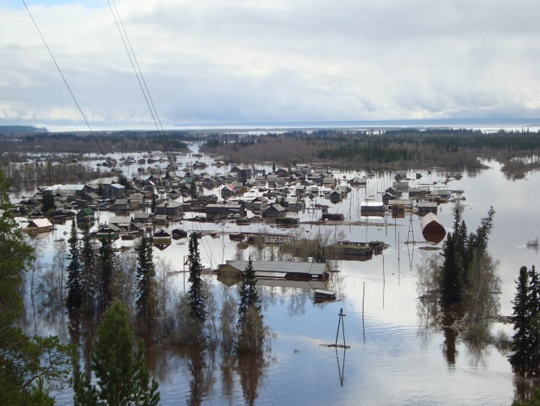


Application
Help determine ice jams and forecast ice-jam floods by observing ice movement and evolution of flooding water.
Ice jam
Edeytsy
VIIRS flood map shows the Ice-jam flood along the Lena River, Russia in May 2013.
Lena River
Notes:
River/ice image showing the ice jam and flood inundation on the Lena River in the village of Edeytsy. This new monitoring technique was shared with staff from Roshydromet, Lena River Basin Water Management Staff, and during the Northern Forum Climate and Water Working Group meeting.

Slide 17
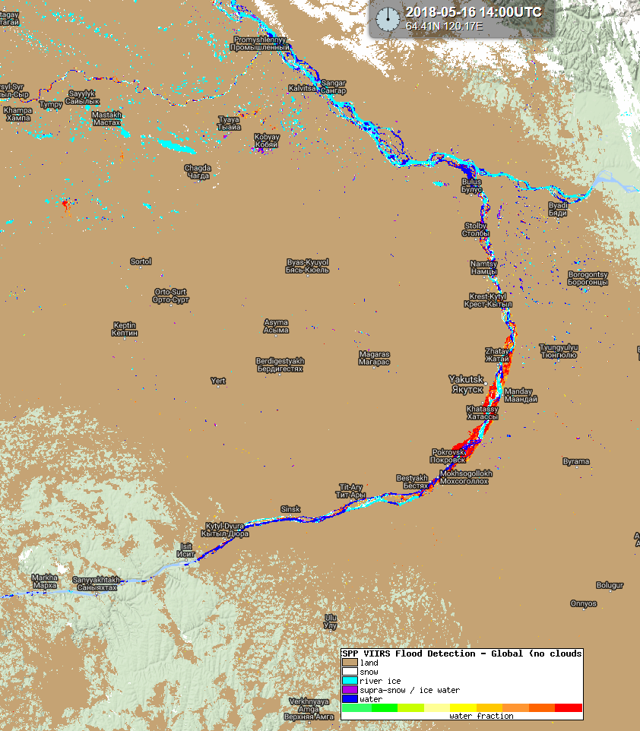
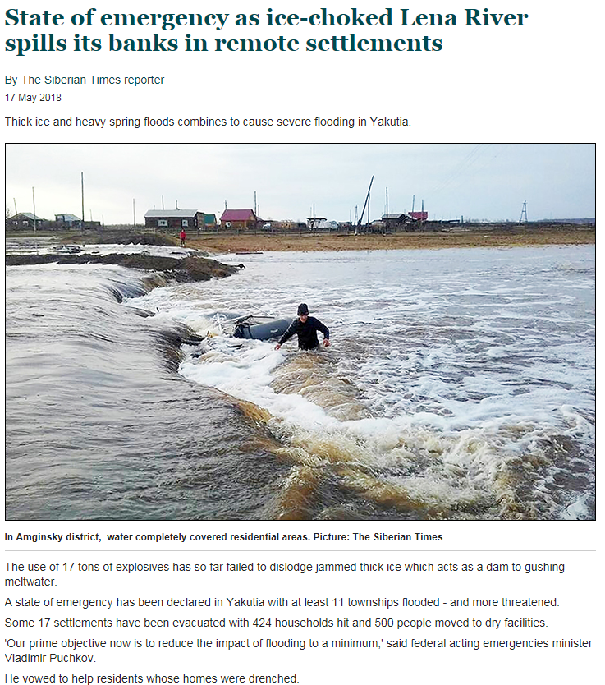
Ice-jam flood near Yakutsk, Russia along the Lena River

Slide 18
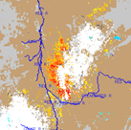
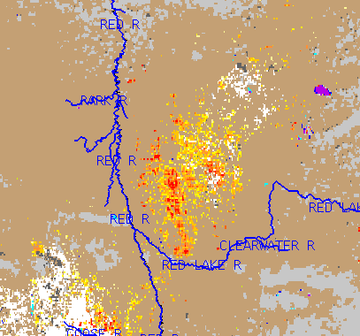
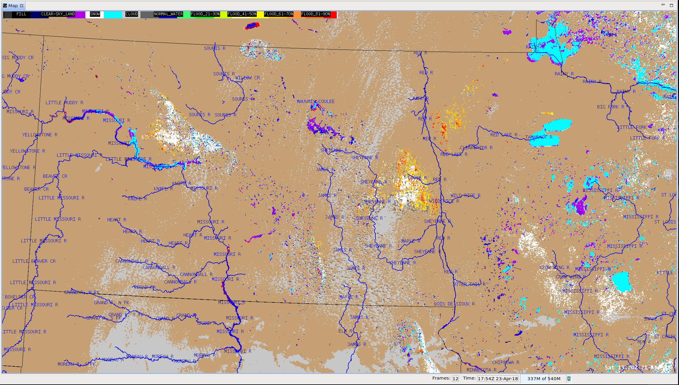
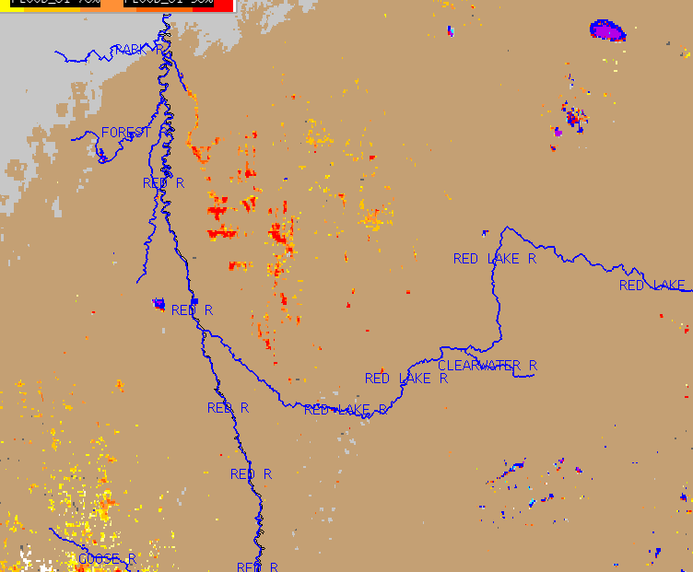
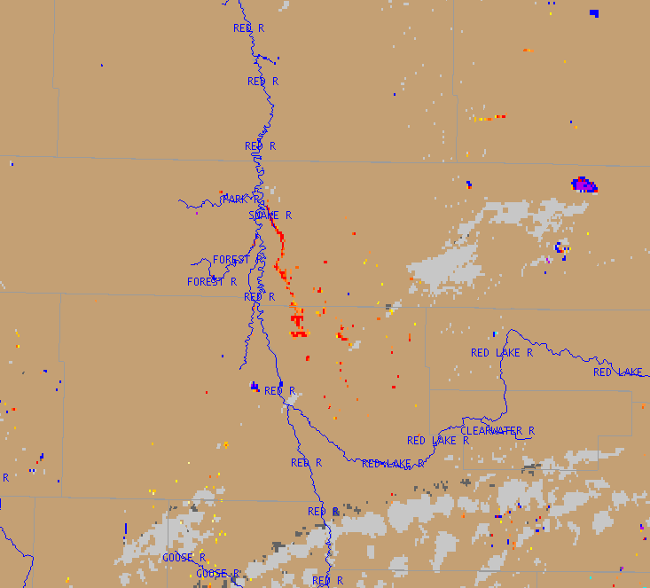
Application
Help determine water movement during snow-melt season.
Where is the water going?
04.21
04.18
04.19
Note how the Snake River channel has accumulated nearly all of the runoff and is showing significant amounts of water compared to the surrounding area.
04.22
04.23
VIIRS flood maps indicated the dynamic change of snowmelt floodwater along the Red River Basin, Minnesota, USA in April, 2018.

Slide 19
Issues with the VIIRS flood detection
Cloud cover is the major limitation for flood detection using the VIIRS imagery, which prevents continuous detection on flood water and causes latency to detect flood water from intensive rainfall.
  The contradiction is: no clouds, no rainfall, and then no floods.
  Latency may prevent the product from flood prediction, but is still okay for flood extent investigation and loss assessment.

Slide 20
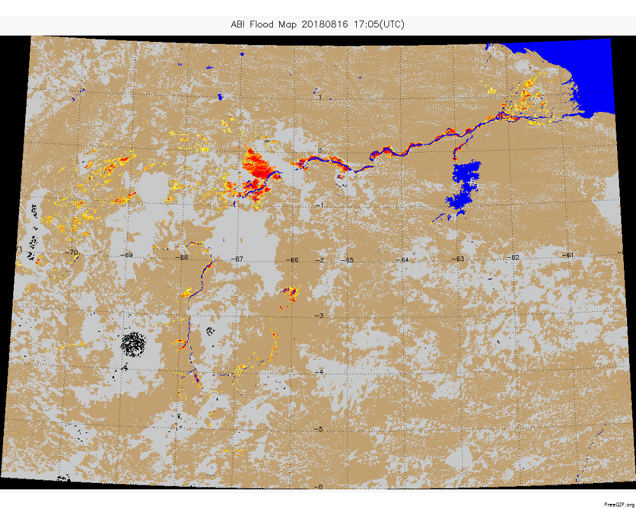
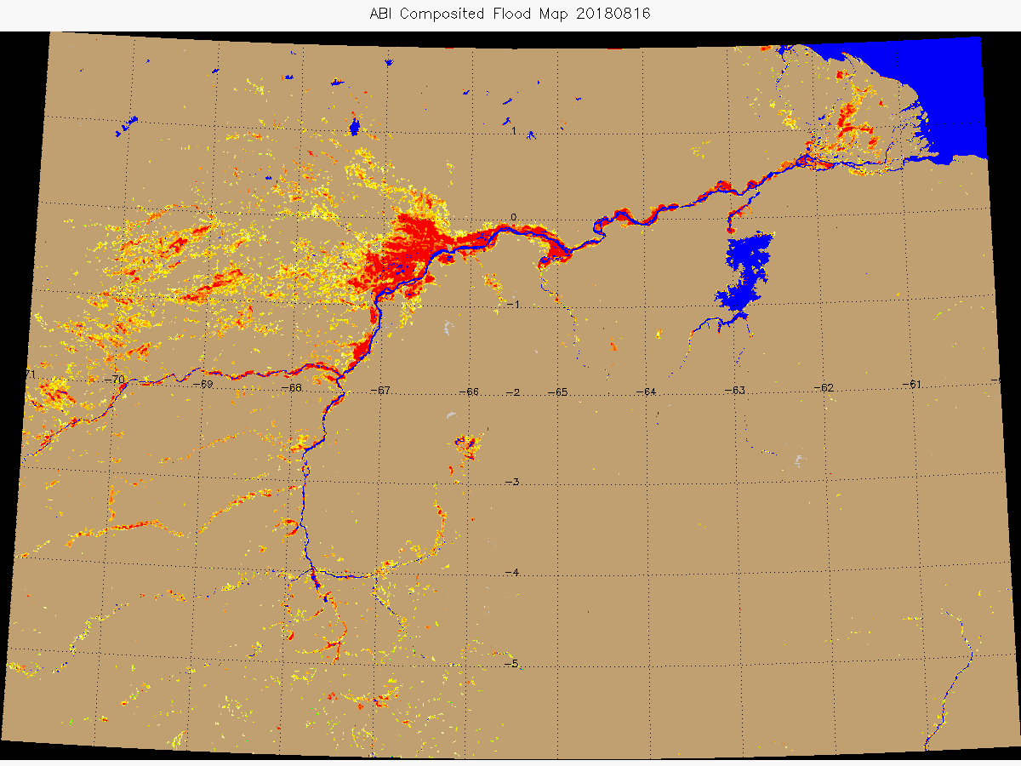
Strength of GOES-16/ABI Flood maps
GOES-16/ABI flood animation in Venezuela on Aug. 16, 2018
GOES-16/ABI daily composition produces a completely clear-sky flood map in Venezuela on Aug. 16, 2018
The 15-minute GOES-16/ABI flood maps produce a completely clear-sky daily flood map.

Slide 21
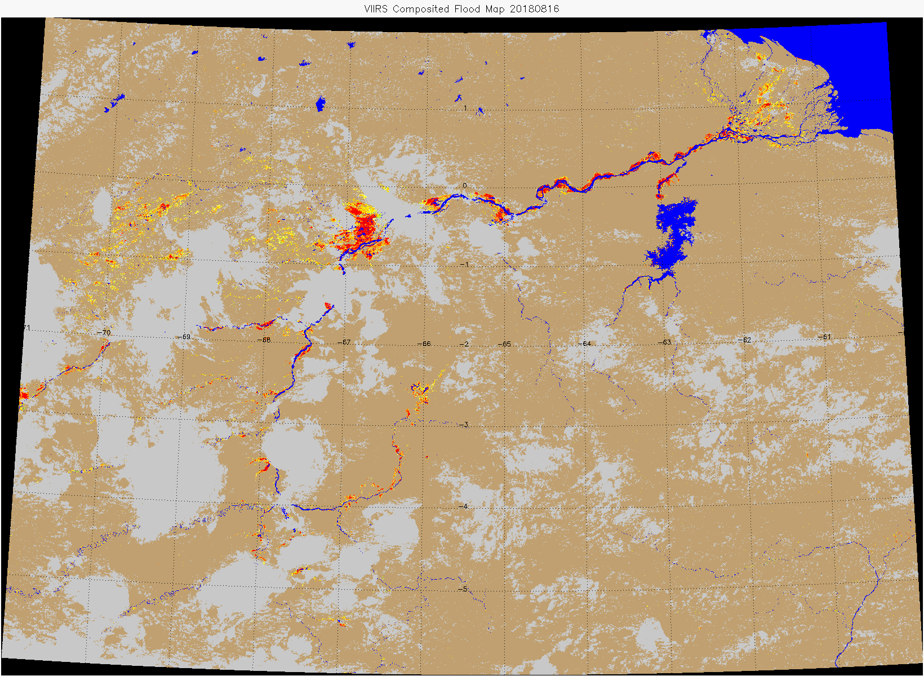
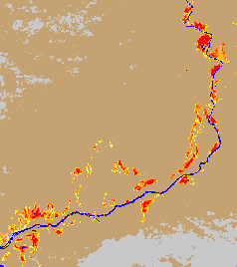

VIIRS
VIIRS 375-m flood map shows more detail
ABI
ABI flood map is completely clear-sky

Slide 22


Joint ABI/VIIRS flood maps
VIIRS
ABI
Blended
The joint ABI/VIIRS flood maps inherit both the maximal clear-sky coverage from the ABI results and the good inundation detail from the VIIRS results.

Slide 23

Development of the ABI flood mapping software
Adjusted from the VIIRS flood detection algorithms.
Flood detection is done based on 5-minute ABI data first, and then a composition process is done on all the previous 5-minute flood maps to update the results each hour.

Slide 24


GOES-16/ABI hourly composited flood maps

Slide 25

GOES-16/ABI daily composited flood maps
The ABI daily composited flood maps derive the maximal clear-sky coverage for flood mapping.

Slide 26

VIIRS flood maps

Slide 27
Develop GEO-LEO flood products
Extend the capability to the other satellite imagery
  Himawari-8/AHI flood mapping
  FY-3D/MERSI flood mapping
  FY-4A/AGRI flood mapping
Blend the results together and develop GEO-LEO flood products
  Blended ABI/AHI/AGRI/VIIRS/MERSI flood product
Partially solve the issues from cloud cover for flood mapping

Slide 28

Himawari-8/AHI Flood Mapping
Himawari-8/AHI flood animation in Cambodia on Aug. 21, 2018

Slide 29


Slide 30


Slide 31


Slide 32

FY4A/AGRI Flood Mapping
FY4A/AGRI flood animation in India on Aug. 21, 2018

Slide 33




AGRI
AHI
The spatial resolution of AHI around India decreases to 3-km in longitude direction, which brings issues to the flood detection and geolocation.
AGRI (centering around 104.7º E) has better spatial resolution and geolocation accuracy around India.

Slide 34


FY3D/MERSI Flood Mapping
FY-3D/MERSI flood map in Venezuela shows consistent flood detection results to Suomi-NPP/VIIRS.

Slide 35
Future plan
The VIIRS flood software has already been available in CSPP.
  First released in 2017
  An update was released in 2018
A new version will be delivered to CSPP later this year to fix some issues in the current version.
  Sun glint contamination
  Integrate Clavr-x cloud mask
  Better quality on the minor flood detection
ABI/AHI flood mapping software can be delivered through CSPP/GEO if requested by JPSS Program Office.
Software for blended GEO-LEO flood products can be delivered through CSPP if requested by JPSS Program Office.

Slide 36
Reference
SanmeiLi, DonglianSun, Mitchell Goldberg, Bill Sjoberg, David Santek, Jay P. Hoffman, Mike DeWeese, Pedro Restrepo, Scott Lindsey, Eric Holloway (2017). Automatic near real-time flood detection using Suomi-NPP/VIIRS data, Remote Sensing of Environment, 204 (2018) 672–689
SanmeiLi, DonglianSun, Mitchell Goldberg & Bill Sjoberg (2015). Object-based automatic terrain shadow removal from SNPP/VIIRS flood maps, International Journal of Remote Sensing, Vol. 36, No. 21, 5504–5522
SanmeiLi, DonglianSun, Mitchell Goldberg & Antony Stefanidis (2013). Derivation of 30-m-resolution Water Maps from TERRA/MODIS and SRTM. Remote Sensing of Environment , 134 (2013) 417–430
SanmeiLi, DonglianSun, YunyueYu, Ivan Csiszar, Antony Stefanidis, & Mitch D. Goldberg (2012). A New Shortwave Infrared (SWIR) Method for Quantitative Water Fraction Derivation and Evaluation with EOS/MODIS and Landsat/TM data. IEEE Transactions on Geoscience and Remote Sensing, Vol. 51, Issue 3
Sanmei Li, Donglian Sun & Yunyue Yu (2013). Automatic cloud-shadow removal from flood/standing water maps using MSG/SEVIRI imagery, International Journal of Remote Sensing, 34:15, 5487-5502
DonglianSun, YunyueYu, RuiZhang, SanmeiLi, and Mitchel D. Goldberg (2012). Towards Operational Automatic Flood Detection Using EOS/MODIS data. Photogrammetric Engineering & Remote Sensing, 78 (6).

Slide 37

Thanks!

